Slide 1
Introducing Microservices and Cloud Native Application Architecture
By: Muhammad Asif Tasleem

Slide 2
AGENDA
What are Microservices?
Twelve Factor Apps
What does it mean to be Cloud Native?
Developing and Deploying Microservices
Questions
Summary

Slide 3
What are Microservices?

Slide 4
Monolithic Application Architecture

Slide 5
What are Microservices?
Monolithic Application

Slide 6
What are Microservices?
Monolithic Application
Modularity

Slide 7
What are Microservices?
Monolithic Application
Scaling

Slide 8
What are Microservices?
Monolithic Application
Failing
✗

Slide 9
What are Microservices?
Monolithic Application
Failing
✗

Slide 10
What are Microservices?
Monolithic Application
Failed
✗
✗
✗
✗

Slide 11
What are Microservices?
Monolithic Application
Update

Slide 12
What are Microservices?
Monolithic Application
Revolution

Slide 13

What are Microservices?
Monolithic Application
Develop

Slide 14
Big Application Ailments (Review)
Big Budgets
Expensive to Change
Slow Payback of Return on Investment
Gold Plated with many Unused Features
Difficult to Scale
Long release cycles and big delays
Source of Conflict between IT & Business Budgets
Drag on Business Model Innovation

Slide 15
What is Domain Driven Design?
It is a way of thinking and a set of properties, aimed at accelerating software projects that have to deal with complicated domains.
A Model Driven software design approach used to tackle the complexity of the software projects.
Collections of principles and patterns that help developers craft elegant systems.

Slide 16
Core Principles of Domain Driven Design?
Ubiquitous Language
Models and Contexts (Bounded Context)
Layers and Hexagons

Slide 17
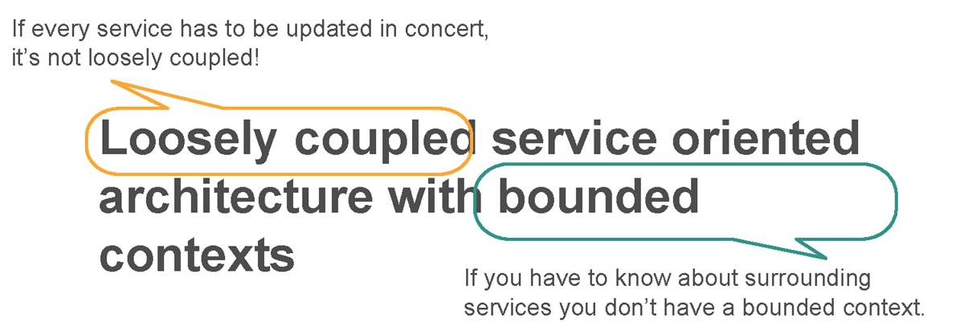
Microservices Architecture

Slide 18
What are Microservices?
Microservices Application

Slide 19
What are Microservices?
Microservices Application
Interactions

Slide 20
What are Microservices?
Microservices Application
Scaled

Slide 21
What are Microservices?
Microservices Application
Evolution

Slide 22
Monolithic versus Microservices
 | Monolithic | Microservice
Architecture | Built as a single logical executable (typically the server-side part of a three tier client-server-database architecture) | Built as a suite of small services, each running separately and communicating with lightweight mechanisms
Modularity | Based on language features | Based on business capabilities
Agility | Changes to the system involve building and deploying a new version of the entire application | Changes can be applied to each service independently
Scaling | Entire application scaled horizontally behind a load-balancer | Each service scaled independently when needed
Implementation | Typically written in one language | Each service implemented in the language that best fits the need
Maintainability | Large code base intimidating to new developers | Smaller code base easier to manage
Transaction | ACID | BASE

Slide 23
Microservice Challenges
Greater operational complexity – more moving parts
Devs need significant Ops skills
Service interfaces and versioning
Duplication of effort across service implementations
Additional complexity of creating a distributed system – network latency, fault tolerance, serialization, …
Designing decoupled non-transactional systems is hard
Avoiding latency overhead of large numbers of small service invocations
Locating service instances
Maintaining availability and consistency with partitioned data
End-to-end testing

Slide 24
Twelve Factor Apps (12factor.net)

Slide 25
Twelve Factor Apps (12factor.net)
Codebase
One codebase tracked in revision control, many deploys

Slide 26
Twelve Factor Apps (12factor.net)
Dependencies
Explicitly declare and isolate dependencies
Typically platform dependent e.g. npm, bundler or Liberty feature manager
Never rely on system-wide dependencies

Slide 27
Twelve Factor Apps (12factor.net)
Config
Store config in the environment
Separate config from source
Avoid “config groups”

Slide 28
Twelve Factor Apps (12factor.net)
Backing Services
Treat backing services as attached resources
Local and remote resources should be treated identically

Slide 29
Twelve Factor Apps (12factor.net)
Build, release, run
Strictly separate build and run stages

Slide 30
Twelve Factor Apps (12factor.net)
Processes
Execute the app as one or more stateless processes
Never rely on sticky sessions

Slide 31
Twelve Factor Apps (12factor.net)
Port binding
Export services via port binding

Slide 32
Twelve Factor Apps (12factor.net)
Concurrency
Scale out via the process model
Individual VMs can only scale vertically so far
Stateless nature makes scaling simple

Slide 33
Twelve Factor Apps (12factor.net)
Disposability
Maximize robustness with fast startup and graceful shutdown
Application instances are disposable
Crash-only design is logical conclusion

Slide 34
Twelve Factor Apps (12factor.net)
Dev/prod parity
Keep development, staging, and production as similar as possible
Use the same backing services in each environment

Slide 35
Twelve Factor Apps (12factor.net)
Logs
Treat logs as event streams
Don’t write to log files

Slide 36
Twelve Factor Apps (12factor.net)
Admin processes
Run admin/management tasks as one-off processes
E.g. database migrations or for debugging

Slide 37
What does it mean to be Cloud Native?

Slide 38
Cloud Native Architecture
Cloud Native describes the patterns of high performing organizations delivering software faster, consistently and reliably at scale.
How quickly can you react to customer changes or the speed of your market?
Can you experiment with ideas, learn from mistakes and identify patterns that work

Slide 39
What does it mean to be Cloud Native?
Clean contract with underlying OS to ensure maximum portability
Scale elastically without significant changes to tooling, architecture or development practices
Resilient to inevitable failures in the infrastructure and application
Instrumented to provide both technical and business insight
Utilize cloud services e.g. storage, queuing, caching, …
Rapid and repeatable deployments to maximise agility
Automated setup to minimize time and cost for new developers

Slide 40
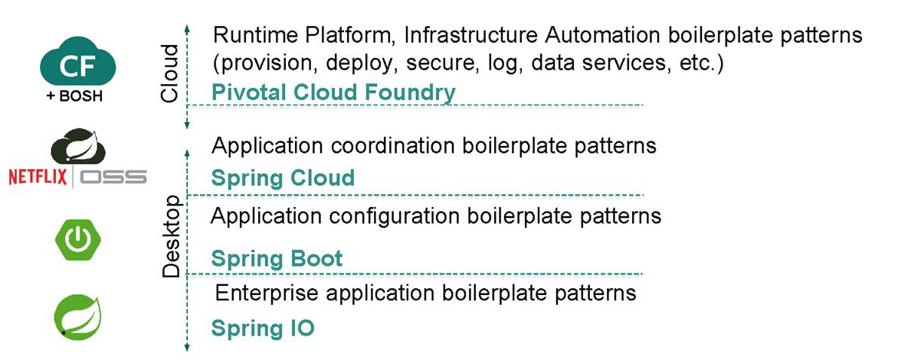
Anatomy of Cloud Native Framework

Slide 41
Developing & Deploying Microservices?

Slide 42
Reducing Operational Complexity
Platform-as-a-Service exists to remove the complexity of deploying applications – the PaaS provider also handles the complexity of managing and monitoring the infrastructure
Cloud Foundry provides a consistent deployment mechanism regardless of programming language
Buildpacks ensure that applications are kept up-to-date with new versions of the runtime and libraries
Routing and load balancing handled by Cloud Foundry router
Service dependencies are resolved at deployment time
Repeatable deployment through IBM DevOps Services or CLI, Maven/Gradle/Travis/Jenkins plugins (you can even run Jenkins on Cloud Foundry!)
Cloud Foundry V3 API to allow multiple processes per app

Slide 43
Service Discovery
Within a Cloud Foundry environment, routes and the CF router provide all that is needed to locate a service instance
Cloud Controller manages distribution and availability of application instances
Blue-green deployments supported by binding multiple application versions to the same route
cf cups (create user provided service) provides a convenient mechanism to inform one microservice of the route for a microservice on which it is dependent
Where instances of a microservice are deployed to multiple Cloud Foundry environments, consider using a runtime registry e.g. Eureka or highly-available data store e.g. etcd, consul or Zookeeper

Slide 44
Communication Protocols
Cloud Foundry currently only supports inbound HTTP
Web sockets is an option in preference to long polling
JSON may be the best fit for client facing services but consider other options such as Apache Thrift or Google Protocol Buffers where serialization efficiency is important
Typically start with synchronous protocols and add asynchronous (e.g. via MQ Light) where needed to support the interaction style or performance goals
Parallel invocation of downstream services may be required to ensure responsiveness is maintained
Consider using a reactive programming model (e.g. RxJava) or Java 8’s CompletableFuture

Slide 45
Design for Failure
Any service call could fail where failure could be anything from an immediate error code to never returning – need to handle that gracefully
Emphasis on real-time monitoring of technical and business metrics
Application monitoring through Monitoring and Analytics service or third-party service e.g. New Relic
Gives insights which might not be uncovered in a monolithic application
Implement patterns from ‘Release It!’ e.g. via Netflix Hystrix
Circuit Breaker – protect from downstream failures
Bulkhead – limit resources that can be consumed
Timeout
Testing for failures: Simian Army

Slide 46
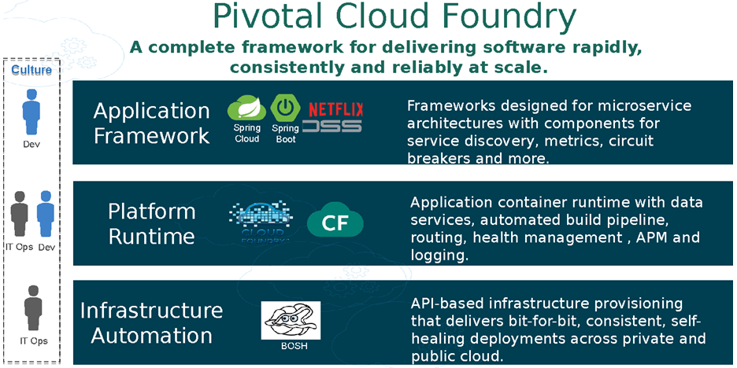
Pivotal Cloud Foundry

Slide 47
Spring Boot
Spring Boot provides a quick way to create a Spring based application from dependency management to convention over configuration.
Key Features:
Stand-­alone Spring applications
No code generation/No XML Config
Automatic configuration by creating sensible defaults
Starter dependencies
Structure your code as you like
Supports Gradle and Maven
Common non-­functional requirements for a "real" application
embedded servers
security, metrics, health checks
externalized configuration

Slide 48
Spring Cloud
Spring Cloud–an open-source library–makes it easy to develop JVM applications for the cloud. With it, applications can connect to services and discover information about the cloud environment easily in multiple clouds such as Cloud Foundry, AWS and Heroku.
Key Features:
Distributed/versioned configuration
Service registration and discovery
Routing
Service-to-service calls
Load balancing
Circuit Breakers
Global locks
Leadership election and cluster state
Distributed messaging

Slide 49
Example: Distributed System (Minified)

Slide 50
Example: Spring Cloud Services + Netflix OSS

Slide 51
Questions?

Slide 52
Credits
Introduction to Microservices and Cloud Native Application Architecture by David Currie, Senior Software Engineer (david_currie@uk.ibm.com)
Cloud Native Java Microservices by Kenny Bastani, Spring Developer Advocate
Pivotal Labs

Slide 53
Summary
What does it mean to be Cloud Native?
Twelve Factor Apps
What are Microservices?
Developing and Deploying Microservices

